Slide 1
Introduction to Computing
CMPE150
Chapter 6
PS
Week 12

Slide 2
Dictionaries and Sets
Sets are used to store multiple items (unique values) in a single variable.
Dictionaries are special forms of sets that contain key:value pairs based on unique set of key entries.
Note: The same value can be assigned to different keys.

Slide 3
Dictionaries and Sets
update() can be used for reassigning/changing the value for a specific key, the previous value will be replaced.

Slide 4
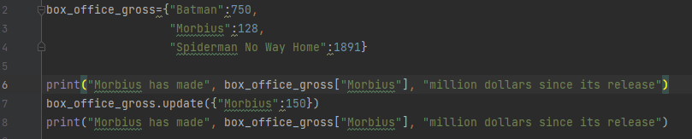
CODE

Slide 5

CODE
OUTPUT

Slide 6
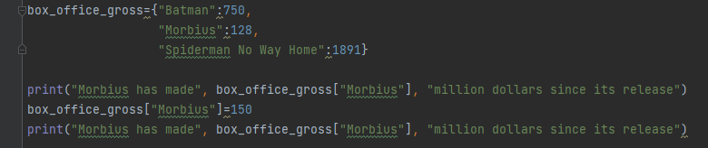
CODE
OUTPUT
Alternative method
for the same result

Slide 7
Dictionaries and Sets
keys() method can be used for retrieving the set of keys in a dictionary, dict_keys.
get() function has the similar results for accesing the dictionary items as the [] operator.
update() can be used for reassigning/changing the value for a specific key, the previous value will be replaced.

Slide 8
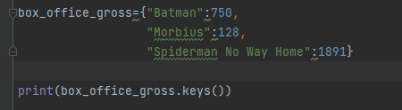
CODE

Slide 9
CODE
OUTPUT

Slide 10
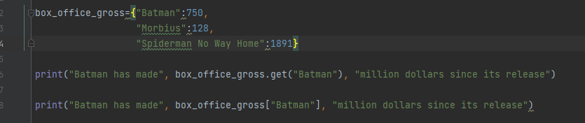
CODE
OUTPUT
CODE

Slide 11

CODE
OUTPUT
CODE
OUTPUT

Slide 12
Dictionaries and Sets
items() method can be used for retrieving the set of keys and their values in a dictionary, dict_items.
in keyword can act as an iteration operater when used in a for loop, similar to its function in strings and lists.
keys() method can be used for retrieving the set of keys in a dictionary, dict_keys.
get() function has the similar results for accesing the dictionary items as the [] operator.

Slide 13
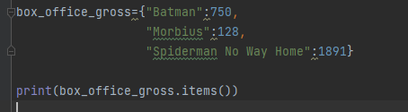
CODE

Slide 14
CODE
OUTPUT

Slide 15
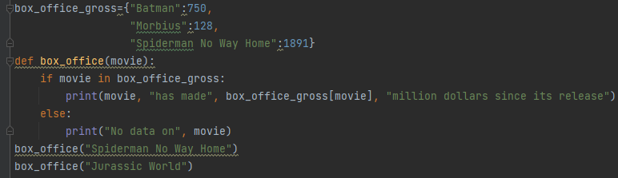
CODE
OUTPUT
CODE

Slide 16
CODE
OUTPUT
CODE
OUTPUT

Slide 17
Dictionaries and Sets
Items in a dictionary can be removed by using the del keyword or the pop() method.
items() method can be used for retrieving the set of keys and their values in a dictionary, dict_items.
in keyword can acts as an iteration operater when used in a for loop, similar to its function in strings and lists.

Slide 18
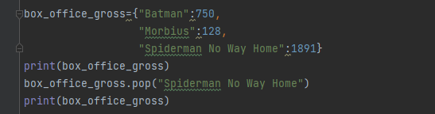
CODE

Slide 19

CODE
OUTPUT

Slide 20
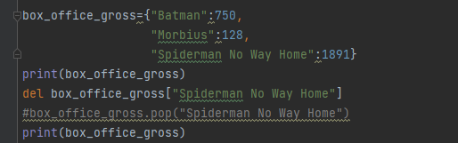
CODE
OUTPUT
CODE

Slide 21
CODE
OUTPUT
CODE
OUTPUT

Slide 22
Dictionaries and Sets
The contents of a dictionary or a set can be fully removed by using the clear() method.
Dictionaries or sets can be totally removed, making them inaccessible, by using the del keyword.
Items in a dictionary can be removed by using the del keyword or the pop() method.

Slide 23
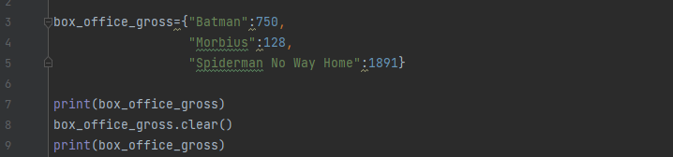
CODE

Slide 24

CODE
OUTPUT

Slide 25
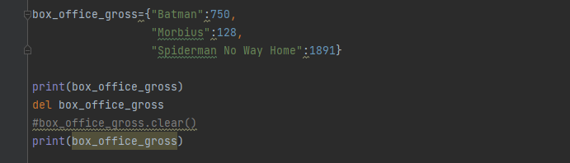
CODE
OUTPUT
CODE

Slide 26
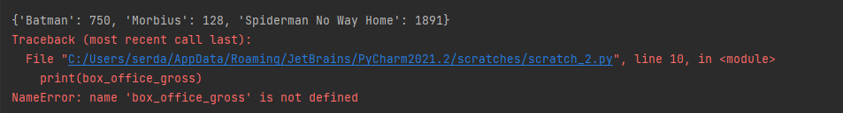
CODE
OUTPUT
CODE
OUTPUT

Slide 27
Dictionaries and Sets
Items can be removed from a set by using the remove() function.
The contents of a dictionary or a set can be fully removed by using the clear() method.
Dictionaries or sets can be totally removed, making them inaccessible, by using the del keyword.

Slide 28
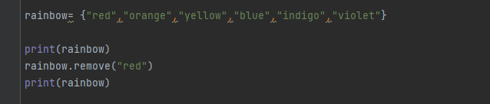
CODE

Slide 29
CODE
OUTPUT

Slide 30
Dictionaries and Sets
Items can also be removed from a set by using the pop() function, but the removed element will be different each time the code is ran, BE CAREFUL WHILE USING.
Items can be removed from a set by using the remove() function.
The contents of a dictionary or a set can be fully removed by using the clear() method.
Dictionaries or sets can be totally removed, making them inaccessible, by using the del keyword.

Slide 31
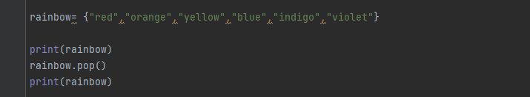
CODE

Slide 32

CODE
OUTPUT 1

Slide 33

CODE
OUTPUT 1
OUTPUT 2

Slide 34

CODE
OUTPUT 1
OUTPUT 2
OUTPUT 3

Slide 35
Dictionaries and Sets
Using the in keyword with keys() or values() methods can make the items in the dictionary accesible.
Items can also be removed from a set by using the pop() function, but the removed element will be different each time the code is ran, BE CAREFUL WHILE USING.
Items can be removed from a set by using the remove() function.
The contents of a dictionary or a set can be fully removed by using the clear() method.

Slide 36
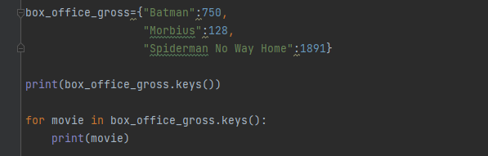
CODE

Slide 37
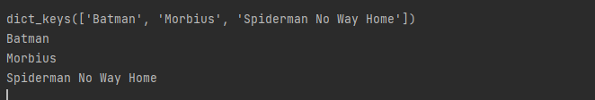
CODE
OUTPUT

Slide 38
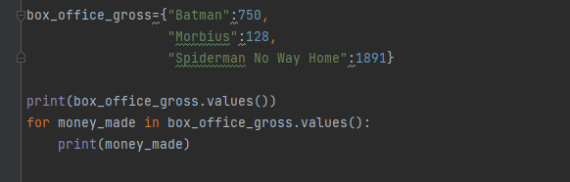
CODE

Slide 39
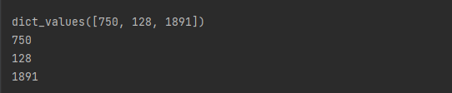
CODE
OUTPUT

Slide 40
Dictionaries and Sets
Using the in keyword with items() method can make the items in the dictionary accesible, as it returns the key-value pair as an iterable tuple.
Using the in keyword with keys() or values() methods can make the items in the dictionary accesible.
Items can also be removed from a set by using the pop() function, but the removed element will be different each time the code is ran, BE CAREFUL WHILE USING.

Slide 41
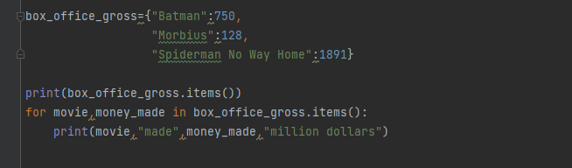
CODE

Slide 42
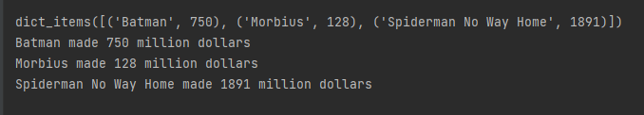
CODE
OUTPUT

Slide 43
Dictionaries and Sets
When a dictionary variable is assigned to other variables, each variable will refer to the same, original, dictionary instance.
The modifications on each variable will be done to the others.
Independent copy of the dictionaries can be produced by using copy() or dict() methods.
Using the in keyword with items() method can make the items in the dictionary accesible, as it returns the key-value pair as an iterable tuple.

Slide 44
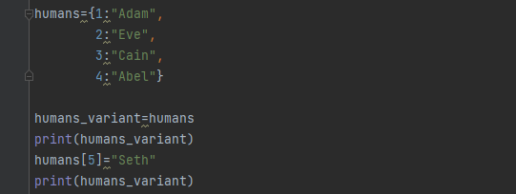
CODE

Slide 45

CODE
OUTPUT

Slide 46
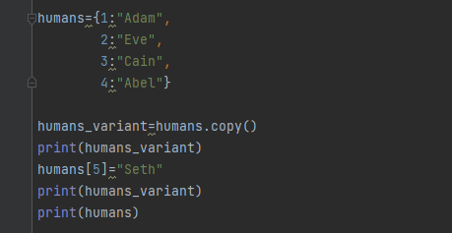
CODE

Slide 47
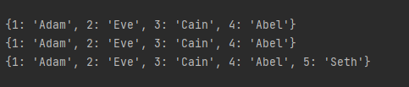
CODE
OUTPUT

Slide 48
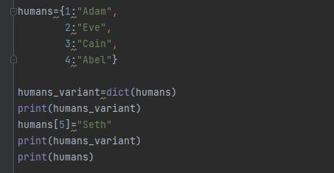
CODE

Slide 49
CODE
OUTPUT

Slide 50
Dictionaries and Sets
dict() method can also be used for constructing a new dictionary from a list of tuples.
When a dictionary variable is assigned to other variables, each variable will refer to the same, original, dictionary instance.
The modifications on each variable will be done to the others.
Independent copy of the dictionaries can be produced by using copy() or dict() methods.

Slide 51
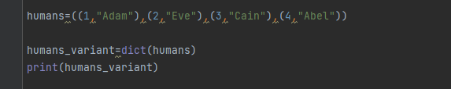
CODE

Slide 52

CODE
OUTPUT

Slide 53
